Slide 1

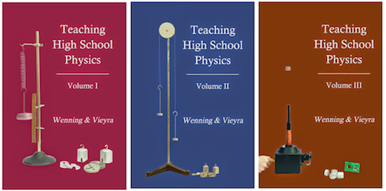
A Review of Selected Chapters from
Teaching High School Physics
Dr. Carl J. Wenning
Physics Department

Slide 2
5. Inquiry in Introductory Physics
It is important for teachers to understand the nature of inquiry.
Science is both process and product.
Teaching content without process is teaching history and not science.
If students don’t learn process, they don’t learn how to think.

Slide 3
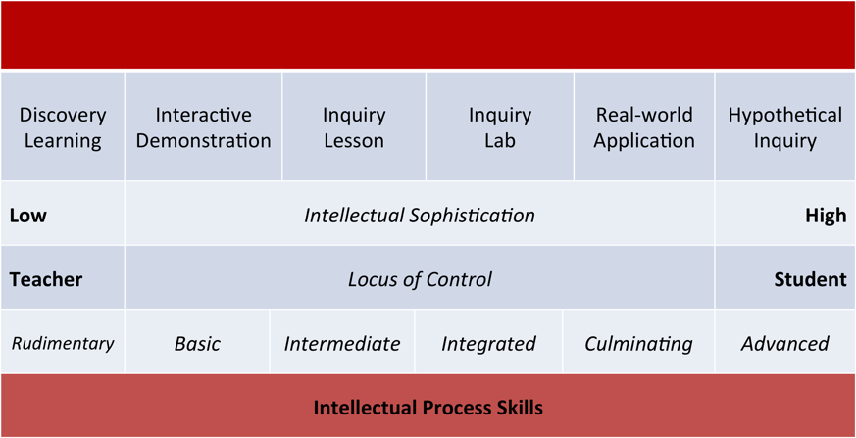
6. Levels of Inquiry

Slide 4
Learning Sequence: v constant
Discovery Learning | Interactive Demonstration | Inquiry Lesson
Using a constant motion vehicle, have students describe that motion. What does one mean by motion? What is “frame of reference”? What is the “origin”? What does one mean by “direction”? What aspects of motion are “quantifiable”? What does one mean by “speed”? What does one mean by “time”? What does one mean by “constant speed”? How does one know when one is seeing constant speed? Distinguish between position and distance and between speed and velocity. Introduce sign convention “right is positive; left is negative” and similar including directions such as north versus south and east versus west. | Tie a constant motion vehicle to a string and fix the free end of the string to a point on the ground thus allowing the vehicle to move with circular motion. Have students predict average speed and average velocity after one complete circle. After one circuit, examine the concepts of distance and displacement with respect to the origin. Distinguish between vector and scalar quantities distance versus displacement and speed versus velocity. Distinguish between average speed, s_{ave}, and average velocity, v_{ave}. | Inquiry Lesson: Derive the relationship x = v_{ave}t + x_{o} from a position versus time graph using the description of a straight line from algebra, y = mx + b. Help students realize that s_{ave} = (X – Xo)/Δt and v_{ave} = (x - x_{o})/Δt where X - X_{o} = ΔX (distance) and x - x_{o} = Δx (displacement). Discuss a variety of sample graphs helping students to understand their meanings. Examples include positive, negative, and zero slopes and intercepts.

Slide 5
Learning Sequence: v constant
Inquiry Lab | Real-world Applications | Hypothetical Inquiry
Using stopwatches and meter sticks to collect data, students create a position versus time graph. They manually determine the best-fit line, calculate the slope and y-intercept, and compare with the results obtained using the computer program Graphical Analysis. Teacher compares algebraic versus physical models to address any discrepancy with the y-intercept. Fit graph with y = mx (proportional fit) versus y = mx + b (linear fit) as appropriate. Students model the behavior of an object whose motion is depicted on a position versus time graph. Use graph matching if an acoustical motion detector is available. Introduce students to motion maps to characterize motion depicted on a graph. Make certain that when students are given a position versus time graph, a motion map, or an algebraic representation of constant velocity motion, they can accurately create the other two representations. | Apply the knowledge derived from experiment to real-world situations: •Using formula (includ- ing units) from the inquiry lesson to solve standard textbook problems that are “demonstrated” prior to solving. • Use a formula from the inquiry lesson to (a) determine the distance of lightning strike after seeing the flash and hearing the thunder; and (2) solve the “World War I: Finding Big Bertha” problem when time between flash and sound of the canon blast are heard from two widely separated locations. Using a graphical representation, find the position where two constant motion vehicles moving toward each other with different speeds will meet in a demo derby. | Have students develop and explain what velocity versus time graphs would look like given graphs of position versus time. Using an acoustical motion detector, compare x-t and v-t graphs for several samples of constant motion, both positive and negative. Have students determine whether or not initial position (or any position at all) is available in a v-t graph.

Slide 6
Draft Learning Sequence: Lenses
Discovery Learning | Interactive Demonstration | Inquiry Lesson
Pinhole camera: understand-ing inverted formation of pro-jection; convex and concave lenses: image formation; focal length, real and virtual images. | Telescope demonstration – convex objective lens forms image; eyepiece magnifies it. | Measuring focal lengths of convex lenses. Work out lens-maker’s formula: 1/f ≈ (n-1) x [1/R₁-1/R₂]
Inquiry Lab | Real-world Applications | Hypothetical Inquiry
Experimentally work out lens formula using a convex lens on an optical bench: 1/f = 1/d_{i} + 1/d_{o} | Solve problems associated with optical systems such as the eye, telescopes, microscopes. | Explain how lenses work using Snell’s law. Explain why concave lenses don’t produce real images. Explain how a magnifying lens works.

Slide 7
7. Scientific Practices-Intellectual Skills
Aim of science is to get students to think.
Levels of thinking:
  Casual or idle thinking
  Assimilative thinking
  Deliberative thinking
Science reasoning skills (32 identified that are associated with various levels of inquiry.)
Critical thinking skills

Slide 8
8. Inquiry of Lower Complexity
Observation versus experimentation.
Generic experimental design:
  Problems, systems, and controls
  Independent & dependent variables
  System parameters
Experiments of low and medium complexity:
  Low – 2 variables: independent & dependent
  Medium – multiples variable; 2-stage experiments
Detailed example of a low complexity lab

Slide 9
9: Inquiry of Higher Complexity
Example of a medium complexity lab activity.
  F = ma
  ΔV = IR
Experiments of high complexity:
  Multiple examples provided
  Mathematical methods emphasized
Example of a higher complexity lab activity:
  I = Σm_{i}r_{i}²
  E_{R} = ½Iω²

Slide 10
10. Mathematical Methods of Inquiry
These have lead to the creation of a Student Laboratory Handbook
http://www2.phy.ilstu.edu/slh/
  Graphing (9)
  Mathematics (13)
  Experimentation (5)
  Equipment (2)

Slide 11
11. Using Technology Effectively
Overview of classroom technology
Why use technology?
ISTE Standards
Technology models (TRACK and SAMR)
Available technology (probes, simulations)
Practical ideas for student use
Strategies for implementing technology

Slide 12
13. Minimizing Resistance to Inquiry
Students get bored with inquiry rather quickly.
They would rather be told what they need to know rather than to work it out themselves.
“A” students are often those who can memorize the best and know how to play the grade game.
The benefits of inquiry need to be clearly and regularly stated for students, parents, admins.

Slide 13
14. Enhancing Student Achievement
There is a wide array of teaching practices that can be used to increase achievement.
Metacognition and self-regulation are among them.
  Metacognition = students knowing what they know
  Self-regulation = students using various strategies
For instance, consider S = A_{i}A_{l}ME₁E₂

Slide 14
15. Active Engagement
These are techniques that teachers can use:
  Worksheets
  Whiteboards
  Socratic dialogues
  Peer teaching
  Practice tests
  Exam question writing
  Reciprocal reading and listening

Slide 15
16. Cooperative Learning
Cooperative learning is not the typical group learning seen in most classrooms.
Among most effective methods for learning
Cooperative learning has very specific guidelines built into it.
Johnson, Johnson, & Holobeck, Circles of Learning, uses the PIGS Face acronym as a reminder. (+interdepend, individ account, group process, social skills, face)

Slide 16
25. Social and Emotional Learning
As teachers we should attempt to educate the whole student – not just the academic part.
Student academic achievement is strongly related to social & emotional well-being.
Social Skills and Emotional Skills – self management, self awareness, relationship skills, decision-making skills, etc.
Support networks…

Slide 17
Teaching High School Physics
Intended for:
  physics teacher education
  in-service teachers
Book availability:
  Amazon.com (for Kindle Reader)
  Google Play Books (for browser)
Visit our books’ website:
sites.google.com/site/teachinghighschoolphysics/

